Slide 1
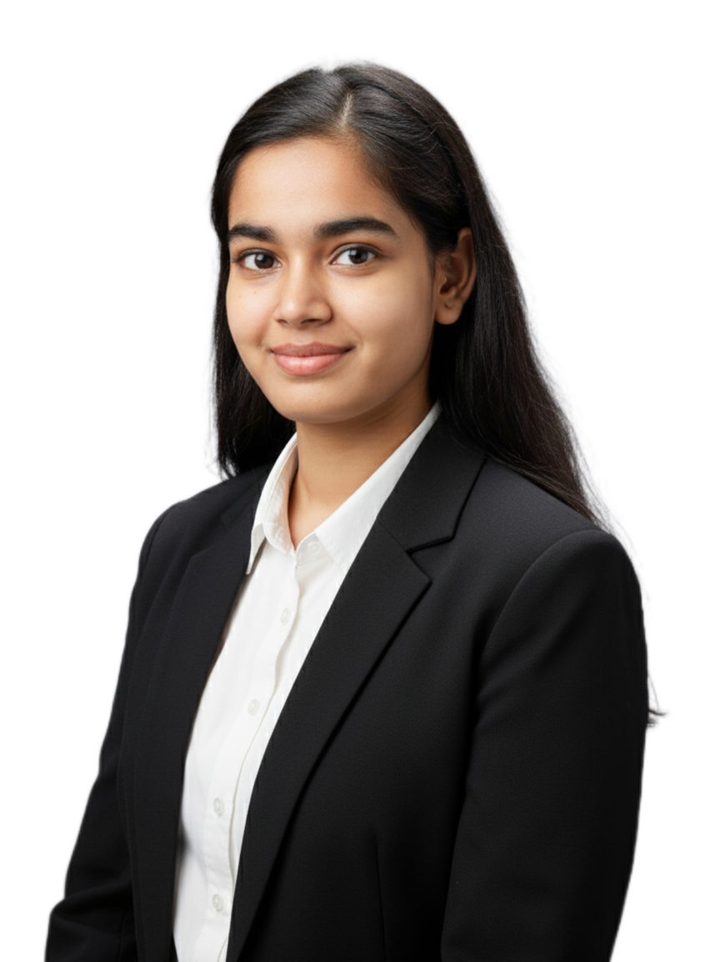

Project Title - Netflix Dataset Analysis — Content Trends & Strategic Recommendations
Name: Priya Kumari
Department: B.Sc. Botany Honours
College Name: Marwari College, Ranchi
Internship ID: INTERNSHIP_17546440516895be537820f
Apply ID: APPLY_17549023086899af2411eb5
10/1/2025
Annual Review
‹#›

Slide 2

PROBLEM STATEMENT
Netflix, one of the leading streaming platforms, faces strong competition from
global and regional OTT providers. To remain competitive, Netflix must analyze its
content catalog to understand distribution trends of Movies vs TV Shows, genre
performance, and country contributions. This project aims to uncover insights from
the dataset to guide strategic content decisions.
10/1/2025
Annual Review
‹#›

Slide 3
Project Description
The project utilizes a Netflix dataset consisting of 7,789 records and 11 columns. It
includes details like title, director, cast, country, release date, rating, duration, and
category (genre). The analysis focuses on identifying content trends across years,
countries, and genres to provide recommendations for Netflix’s strategic planning.
Exploratory Data Analysis (EDA) was performed using Python (pandas, matplotlib)
to generate visual insights and summary tables.
10/1/2025
Annual Review
‹#›

Slide 4

WHO ARE THE END USERS?
- Netflix Content Strategy Team
- OTT Market Analysts
- Data Science & Business Intelligence Teams
- Academic and Research Institutions analyzing streaming
trends
10/1/2025
Annual Review
‹#›

Slide 5

Technology Used
• Python (Pandas, Matplotlib)
• Jupyter Notebook
• Data Cleaning and EDA
• Visualization Tools (Matplotlib, Power BI optional)
• GitHub for version control and
project sharing
10/1/2025
Annual Review
‹#›
Notes:
5

Slide 6
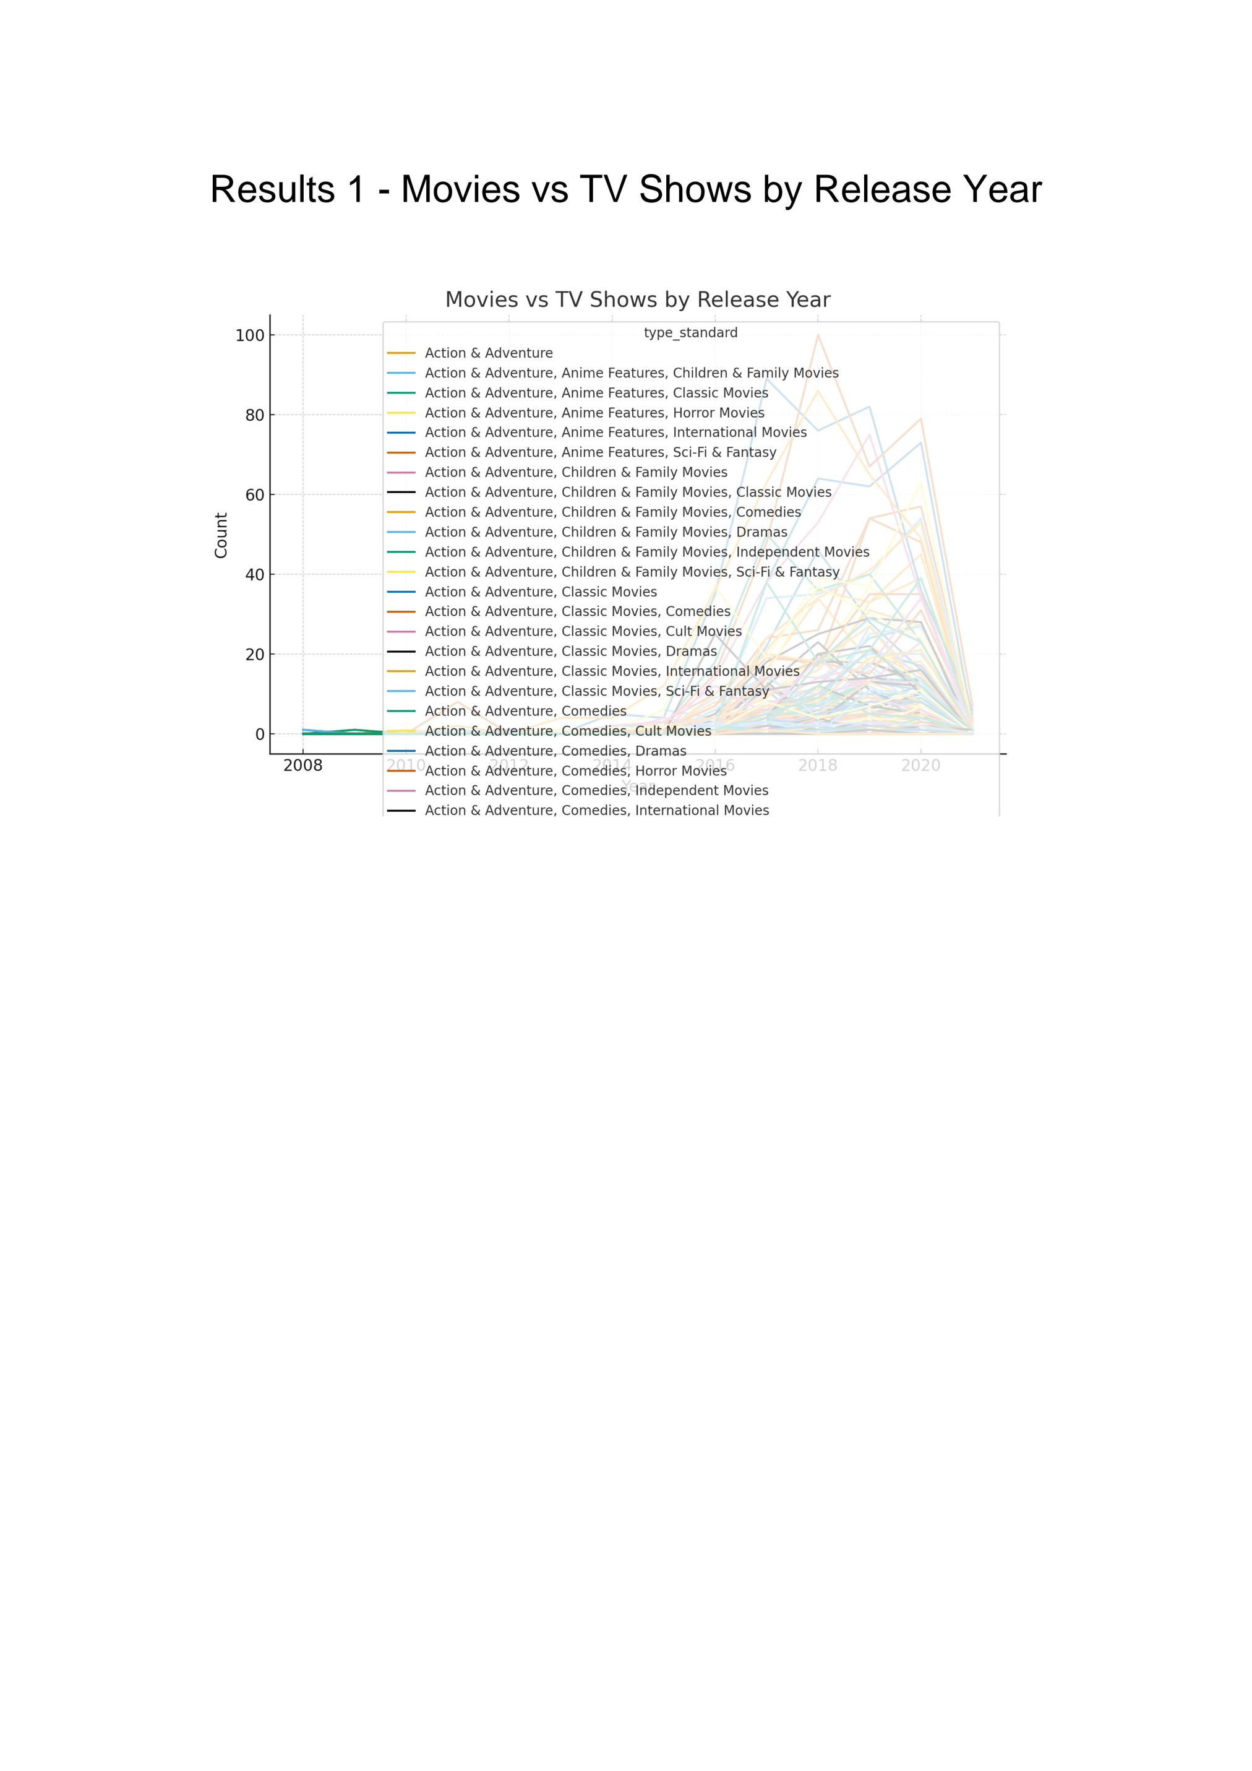
10/1/2025
Annual Review
‹#›

Slide 7
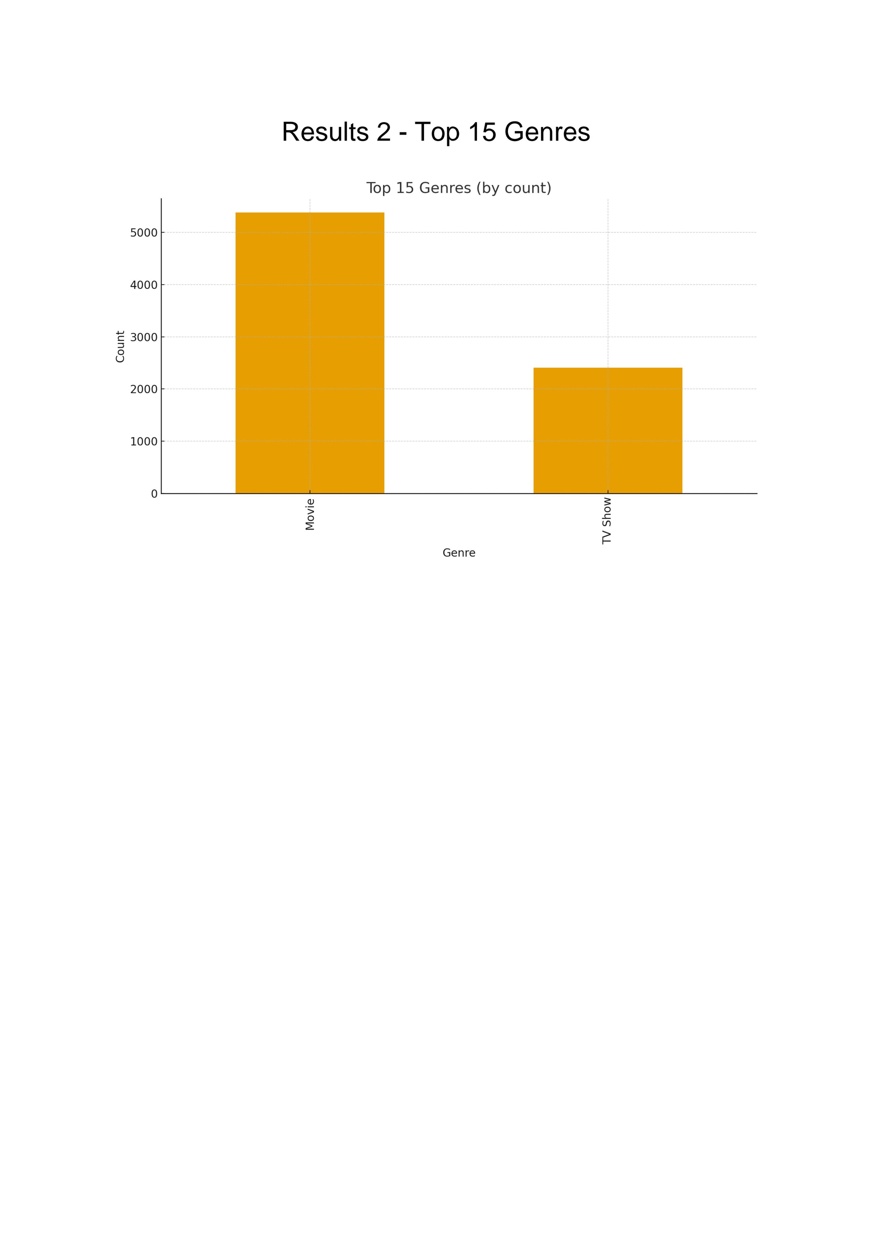
10/1/2025
Annual Review
‹#›

Slide 8
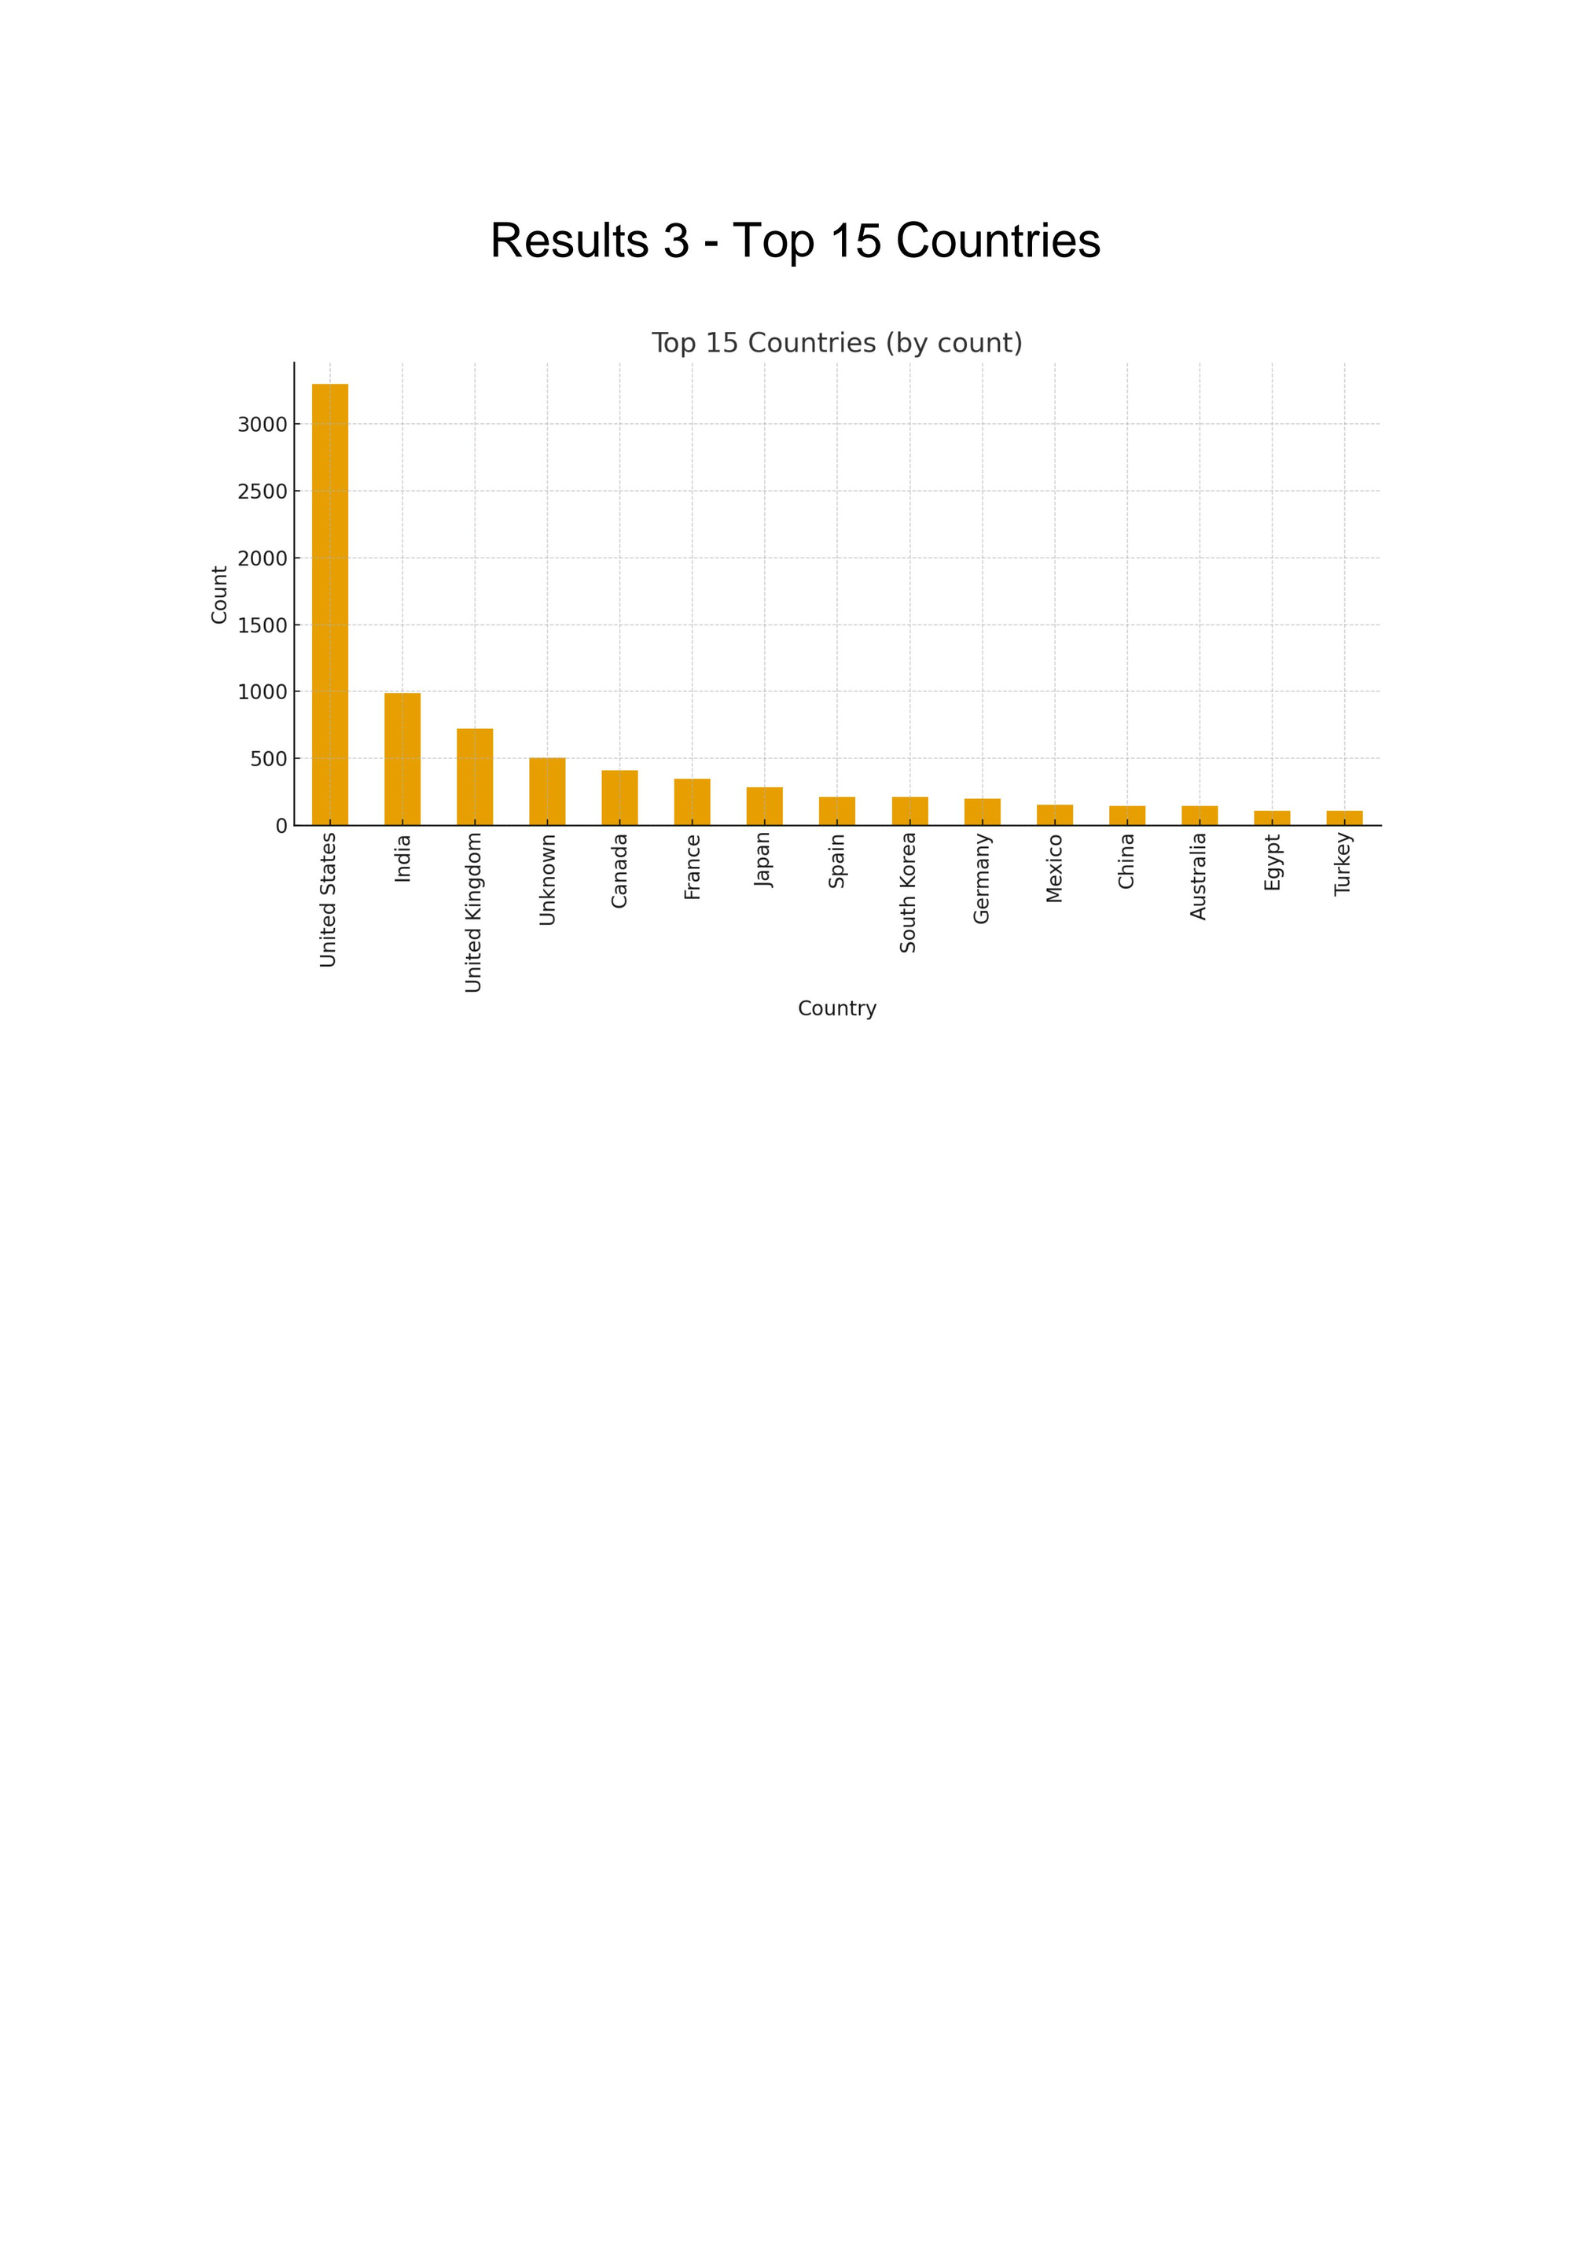
10/1/2025
Annual Review
‹#›

Slide 9
GitHub repository
https://github.com/priyaky/VOIS_AICTE_Oct2025_MajorProject_PriyaKumari
10/1/2025
Annual Review
‹#›

Slide 10

Getting started with Basics of Python Certificate
10/1/2025
Annual Review
‹#›

Slide 11
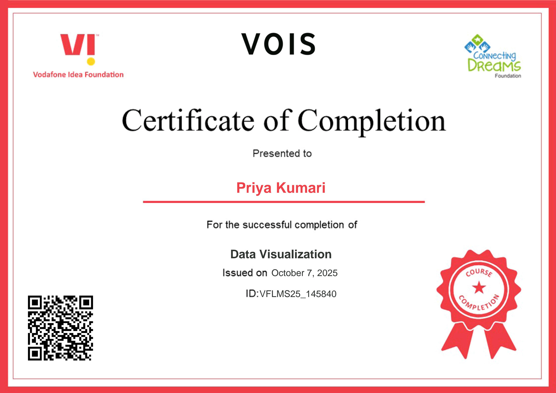
Data Visualization Certificate
10/1/2025
Annual Review
‹#›

Slide 12
Thank you
Project by Priya Kumari AICTE Internship 2025 Netflix Dataset Analysis
.
.
10/1/2025
Annual Review
‹#›

